Slide 1
FAKE NEWS DETECTION USING NLP
College Name: St Joseph College of Engineering
Student Name: Kavipriya

Slide 2
Leveraging Natural Language Processing for Accurate Information

Slide 3
Introduction & Scope of work
We designed to collect a substantial datasets of news articals with labels indicating weather they are fake or real.
What is Fake News?
Fake news is news designed to delibrately spread hoaxes,propaganda and disinformations.
Fake news stories usually spread through social media sites like Facebook,Twitter and Reddit.

Slide 4
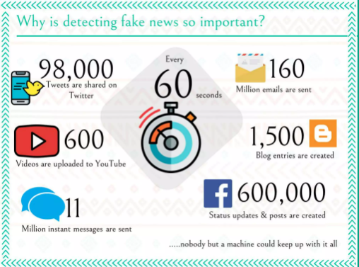
Why is detecting fake news so important?

Slide 5
Problem Definition
The problem of fake news detection using Natural Language Processing (NLP) aims to develop a system capable of automatically identifying and classifying news articles or content as either genuine or fake based on their textual content.

Slide 6
Design Thinking
Empathize: Understand the impact of fake news on society, trust, and democracy.Engage with potential users, journalists, and experts to gather insights on their specific needs and pain points.Analyze existing solutions and their limitations to learn from past efforts.
Clearly define the problem: Develop a detailed problem statement that encapsulates the challenge of fake news detection using NLP.Identify the target audience and stakeholders, such as news consumers, fact-checkers, and content creators.Establish key objectives, such as improving information reliability and trust in media.

Slide 7
Ideate: Brainstorm creative solutions and approaches for fake news detection using NLP.Consider combining various NLP techniques like text classification, sentiment analysis, and entity recognition.Explore the potential integration of user-generated content, user feedback, and expert input.
Prototype: Develop a prototype NLP-based fake news detection system that incorporates the selected techniques.Create a user interface or API to interact with the system.Define data sources, including news articles, social media posts, and relevant datasets for training and evaluation.

Slide 8
Test: Evaluate the prototype's effectiveness using a diverse dataset of real-world examples.Collect feedback from users and experts to identify strengths and weaknesses.Refine the system based on user feedback and test results.
Implement: Build a production-ready fake news detection system based on the refined prototype.Ensure scalability to handle a large volume of data in real-time or batch processing.Implement a user-friendly interface for easy access.

Slide 9
Measure: Define key performance metrics, such as precision, recall, F1-score, and false positive rate.Continuously monitor and assess the system's performance in detecting fake news.Gather user feedback and iterate on the system to improve accuracy and usability.
Iterate: Regularly update and improve the NLP-based fake news detection system to adapt to evolving fake news tactics and emerging challenges.Stay informed about the latest NLP advancements and incorporate them when applicable.Collaborate with experts, fact-checkers, and the user community to refine the system further.

